Slide 1

Medicare 101
The Basics of Medicare

Slide 2


Agenda
We will cover the following topics:
What is Medicare?
Enrollment Periods
Original Medicare
Medicare Advantage
Medicare Supplement
Prescription Drug Plans
Ratings and Summary
Best Practices
2026 Medicare Trends
Q&A Session

Slide 3
What is Medicare?
Health Insurance program for:
  People 65 years of age and older
  People under the age of 65 with certain disabilities
  People with End-Stage Renal Disease (ESRD) or Amyotrophic Sclerosis (ALS)
Administered by the Centers for Medicare & Medicaid Services (CMS)
Enrollment by Social Security Administration (SSA)
Parts A & B = Original Medicare
Parts C & D = Private

Slide 4


Initial Enrollment Period
Six months before
you turn 65
Research the Medicare plans and options available in your area.
Decide which coverage options are most important to you based on your needs and budget.
Three months before
You turn 65
Enroll in Original Medicare (Parts A and B).
Consider which additional plans do the best job of completing your Medicare coverage.
The month you
turn 65
Sign up for the additional Medicare coverage you’ve chosen. You must already be enrolled in Original Medicare (Parts A and B) before you can enroll in additional coverage.
Three months after
you turn 65
Enroll in Original Medicare (Parts A and B).
Consider which additional plans do the best job of completing your Medicare coverage.

Slide 5

Annual Election Period
The Medicare Annual Enrollment Period – AEP for short – is a set time each year for changing your Medicare coverage choices if you choose to. AEP runs from October 15 to December 7. New coverage choices go into effect on January 1.

Slide 6
Medicare Advantage Open Enrollment Period
Beneficiaries get a one-time election from January 1 to March 31 to make any of the following changes through the Medicare Advantage Open Enrollment Period:
Switch from a Medicare Advantage Prescription Drug Plan (MAPD) to a different MAPD.
Switch from an MAPD to an MA-only plan.
Switch from an MA-only plan to an MAPD
Switch from an MA-only plan to a different MA-only plan.
Go back to original Medicare and, if needed, also join a Medicare Prescription Drug Plan

Slide 7
Special Enrollment Periods
You can also make changes to your Medicare Advantage and Medicare prescription drug coverage when certain events happen in your life, like if you move or lose other insurance coverage. These chances to make changes are called Special Enrollment Periods (SEPs).

Slide 8

Your Medicare Coverage Choices at-a-Glance
Hospital
Insurance
Medical
Insurance
Prescription
Coverage
Additional
Benefits
Part A
Original
Medicare
Part B
Medicare
Advantage **
Part C
Prescription Drug Coverage
Part D
** Some Medicare Advantage Plans may provide prescription drug benefits

Slide 9
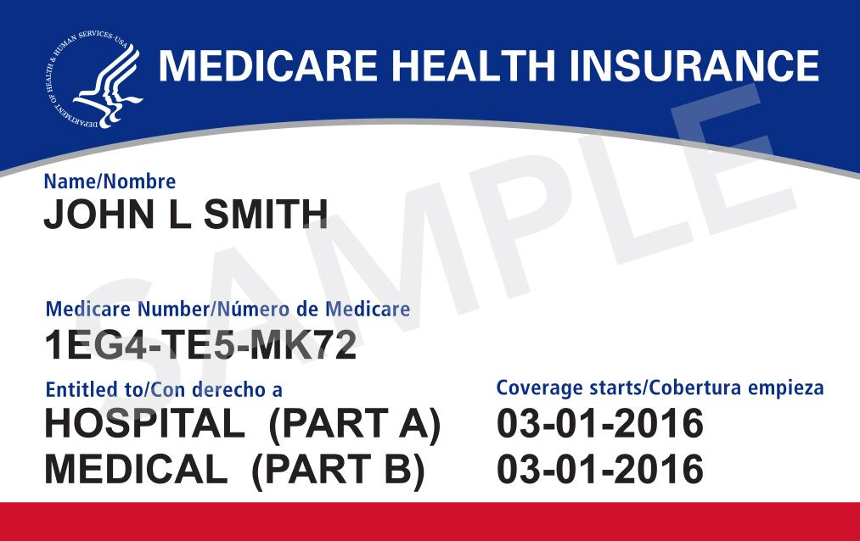
Example of Medicare Card

Slide 10

Original Medicare
Aka Part A + Part B

Slide 11
Medicare Part A
Hospital Insurance
Enrollment is automatic
Helps cover:
Part A Hospital Insurance (Inpatient)
Inpatient Hospital Care
Skilled Nursing Care
Home Health Care
Hospice Care
11

Slide 12
Part A Costs
No Cost
Premium (if Eligible)
Home Health Care
Blood (3 pints)
Hospice Care
Hospitalization*
Days 1-60 | $1,736 (deductible)
Days 61-90 | $434 daily
Days 91-150 | $ 868 daily
Days 151 plus | All costs
Skilled Nursing Facility*
Days 1-20 | $0
Days 21-100 | $217 daily
100 days plus | You pay all costs
*Cost based on CMS 2026 rates.

Slide 13
Medicare Part B
Medical Insurance
Requires a monthly premium, which may be deducted from your social security check. If not it may be billed quarterly.
Helps cover:
Part B Medical Insurance (Outpatient)
Doctors’ Services & Outpatient Care
Preventive Services
Diagnostic Tests
Some Therapies
Durable Medical Equipment
13

Slide 14
Part B Costs
2026 Standard Part B Premium = $202.90*
Beneficiary pays 20% of Medicare-approved amount for doctor services, outpatient therapy and Durable Medical Equipment (DME)
*Cost based on 2026 rates.

Slide 15
Part B Premiums
Full Part B Coverage
Beneficiaries who file individual tax returns with modified adjusted gross income: | Beneficiaries who file joint tax returns with modified adjusted gross income: | Income-Related Monthly Adjustment Amount | Total Monthly Premium Amount
Less than or equal to $109,000 | Less than or equal to $218,000 | $0.00 | $202.90
Greater than $109,000 and less than or equal to $137,000 | Greater than $218,000 and less than or equal to $274,000 | $81.20 | $284.10
Greater than $137,000 and less than or equal to $171,000 | Greater than $274,000 and less than or equal to $342,000 | $202.90 | $405.80
Greater than $171,000 and less than or equal to $205,000 | Greater than $342,000 and less than or equal to $410,000 | $324.60 | $527.50
Greater than $205,000 and less than $500,000 | Greater than $410,000 and less than $750,000 | $446.30 | $649.20
Greater than or equal to $500,000 | Greater than or equal to $750,000 | $487.00 | $689.90
*The 2026 Part B total premiums for high-income beneficiaries with full Part B coverage are shown in the following table

Slide 16
What Original Medicare Doesn’t Cover
Prescription Drugs not covered under Part B Benefits
Out-of-Country Care
Routine Eye Care
Hearing Tests or Hearing Aids
Routine Chiropractic/Acupuncture
Dental
Transportation
Long Term Care

Slide 17
Medicare Advantage
Aka Part C

Slide 18
Medicare Part C
Medicare Advantage
Offers health plan options by Medicare-approved private insurance companies.
Combines benefits and services of:
Part C
Hospital Services (Medicare Part A)
Medical Services (Medicare Part B)
Often includes Prescription Drug Coverage (Medicare Part D)
Some may include additional benefits

Slide 19
Medicare Advantage Costs
Out-of-pocket costs vary by plan (Deductibles and copayments)
Members are still responsible for their Part B premium
In some cases a plan may pay a portion or all of your Part B premium
Each plan has a maximum out-of-pocket

Slide 20
Prescription Drug Plans
Aka Part D

Slide 21
Medicare Part D
Prescription Drug Coverage
Run by Medicare-approved private insurance companies or health plans
Helps pay for generic & brand-name drugs not covered by Original Medicare
Benefits require a minimum standard benefit by Medicare. Formularies vary greatly between plans.
Plans have different premiums, copays, and cover different drugs
Before you sign up, check medications are included in the plan’s formulary

Slide 22
Medicare Prescription Drug Coverage Stages of Enrollment/Coverage Gap 2026
What is Medicare Part D?
Medicare Part D is prescription drug coverage for Medicare beneficiaries.
It is optional and offered through private insurance companies approved by Medicare. However, you may be subject to a late enrollment penalty if you go 63 days without qualified Rx coverage.
Helps cover costs of prescription medications, which are not fully covered under Original Medicare (Part A & B).
Who is Eligible?
Anyone enrolled in Medicare Part A and/or Part B.
Must live in the plan’s service area.
Initial
Coverage
Catastrophic
Coverage

Slide 23
Medicare Prescription Drug Coverage Stages of Enrollment/Coverage Gap 2026
How Part D Works:
Plans have a monthly premium.
Costs vary depending on:
- Deductible (the amount you pay before coverage starts)
- Copayments or coinsurance
- Formulary tiers (generic vs. brand-name drugs)
Plans have a formularies (list of covered drugs) which may change yearly.
Initial
Coverage
Catastrophic
Coverage

Slide 24
Medicare Prescription Drug Coverage Stages of Enrollment/Coverage Gap 2026
Coverage Phases:
          Deductible Phase – You pay full cost until deductible is met.
Initial Coverage Phase – You pay copays/coinsurance, plan pays the rest.
Catastrophic Coverage – After out-of-pocket threshold is reached, you pay small coinsurance or copay for the rest of the year. Until you reach a max out of pocket of $2000
Initial
Coverage
Catastrophic
Coverage

Slide 25
Part D Income Related Adjustment
Part D
Beneficiaries who file individual tax returns with modified adjusted gross income: | Beneficiaries who file joint tax returns with modified adjusted gross income: | Income-related monthly adjustment amount
Less than or equal to $109,000 | Less than or equal to $218,000 | $0.00
Greater than $109,000 and less than or equal to $137,000 | Greater than $218,000 and less than or equal to $274,000 | $14.50
Greater than $137,000 and less than or equal to $171,000 | Greater than $274,000 and less than or equal to $342,000 | $37.50
Greater than $171,000 and less than or equal to $205,000 | Greater than $342,000 and less than or equal to $410,000 | $60.40
Greater than $205,000 and less than $500,000 | Greater than $410,000 and less than $750,000 | $83.30
Greater than or equal to $500,000 | Greater than or equal to $750,000 | $91.00
Initial
Coverage
Catastrophic
Coverage
The 2026 Part D income-related monthly adjustment amounts for high-income beneficiaries are shown in the following table

Slide 26
Medicare Supplement
Aka Med Supp or MediGap

Slide 27
Medicare Supplement
Meant to fill gaps in Original Medicare
Covers deductible, copays and coinsurance that Original Medicare does not cover (varies by plan)
No network restrictions
10 standardized plans (A-D, F, G, K-N)

Slide 28
Things to Know About Med Supp
If you enroll within the 6 month period after turning 65 there will be no effect on price from pre-existing conditions
A beneficiary must have Part A and Part B
You cannot have have Med Supp and MAPD plan simultaneously
Only covers one person
Do not include prescription drug coverage

Slide 29
Summary of Options
 | Medicare Advantage | Medicare Supplement | Original Medicare
Hospital Stays | ✔ | ✔ | ✔
Medical care | ✔ | ✔ | ✔
Preventative services | ✔ | ✔ | ✔
Prescription Drug Coverage | ✔ | ❌ | ❌
Routine vision coverage | ✔ | ❌ | ❌
Routine hearing coverage | ✔ | ❌ | ❌
Routine Dental | ✔ | ❌ | ❌
Limits annual out of pocket costs | ✔ | ✔ | ❌
Gyms, OTC, Worldwide Coverage may be covered by the plan. Benefits and benefit levels may vary. | ✔ | ❌ | ❌
Transportation | ✔ | ❌ | ❌

Slide 30
Best practices for financial planners
Start Medicare Planning at Age 63–64
Clients should begin planning 12–24 months before turning 65.
Why:
Medicare decisions affect taxes, retirement income, and healthcare costs
Avoid late enrollment penalties
Coordinate with employer coverage or retiree benefits
Best practice:
Add Medicare planning review to annual retirement readiness meetings once clients reach age 63.

Slide 31
Best practices for financial planners
2. Identify the Correct Enrollment Window
Understanding enrollment periods prevents permanent penalties.
Key windows:
Initial Enrollment Period (IEP): 7 months around the 65th birthday
Special Enrollment Period (SEP): If staying on employer coverage after 65
Annual Enrollment Period: Oct 15 – Dec 7
Best practice:
Maintain a client Medicare birthday tracker. Reach out to GMBA advisors Group to help you.

Slide 32
Best practices for financial planners
3. Evaluate Employer Coverage Before Switching
Many clients working past 65 should delay Medicare Part B.
Important factors:
Employer size (20+ employees vs <20)
HSA contributions
Cost comparison vs Medicare
Best practice:
Run group plan vs Medicare cost analysis. We can help you with this!

Slide 33
Best practices for financial planners
4. Coordinate Medicare with HSA Contributions
Clients must stop HSA contributions before Medicare enrollment.
Important rule:
Medicare Part A is retroactive up to 6 months
Best practice:
Stop HSA contributions 6 months prior to Medicare enrollment.

Slide 34
Best practices for financial planners
5. Model Healthcare Costs in Retirement Plans
Healthcare is often the 2nd largest retirement expense.
Typical Colorado retirement estimates:
$5,000 – $7,500 per year per person
Higher if using Medicare Advantage or Medigap + drug plan
Best practice:
Add a Medicare cost assumption into retirement projections.

Slide 35
Best practices for financial planners
6. Evaluate IRMAA (Income Related Medicare Premiums)
Higher income retirees pay additional Medicare premiums.
Example 2025 brackets (approx):
Above $103k single / $206k married triggers surcharges.
Best practice:
Coordinate Roth conversions and retirement withdrawals to reduce IRMAA
.

Slide 36
Best practices for financial planners
7. Compare Medicare Advantage vs Medigap Strategically
This is one of the biggest financial decisions clients make at 65.
General differences:
Medicare Advantage Lower monthly premium
Network-based Out-of-pocket limits
Medigap Higher premium
Maximum provider flexibility Predictable costs
Best practice:
Evaluate based on:
  Travel
  Provider preference
  Risk tolerance
.

Slide 37
Best practices for financial planners
8. Review Prescription Drug Coverage
Prescription coverage can dramatically impact costs.
Best practice:
Run annual drug plan comparisons.
Use Part D optimization tools.
Important:
Drug plans change every year. We can help your clients find the right plan based on their needs

Slide 38
Best practices for financial planners
9. Build a Trusted Medicare Specialist Relationship
Financial planners should partner with a Medicare broker, not attempt to handle everything themselves.
Benefits:
Compliance protection
Carrier comparison
Client support
Best practice:
Co-brand Medicare education resources.
(This is especially relevant given your work with GMBA Advisors Group, let’s partner!)

Slide 39
Best practices for financial planners
10. Educate Clients with Medicare Seminars or Webinars
Education builds trust and prevents mistakes.
Top-performing advisor's host:
Medicare 101 workshops
Turning 65 planning webinars
Client retirement transition events
Best practice:
Host sessions for clients aged 63–66 annually.
Off load the Medicare 101 to us, we can be your subject experts

Slide 40
Best practices for financial planners
Bonus Best Practice (Often Overlooked)
Help Clients Set Realistic Expectations
Clients often believe Medicare covers everything.
Explain:
Deductibles
Drug costs
Dental/vision gaps
Long-term care exclusions
This prevents financial surprises in retirement.

Slide 41
Best practices for financial planners
✅ Pro Tip for Financial Advisors
The most successful advisory firms integrate Medicare into their retirement planning process with a simple workflow:
Age 63 – Medicare introduction
Age 64 – Education session
Age 64.5 – Plan comparison
Age 65 – Enrollment support

Slide 42
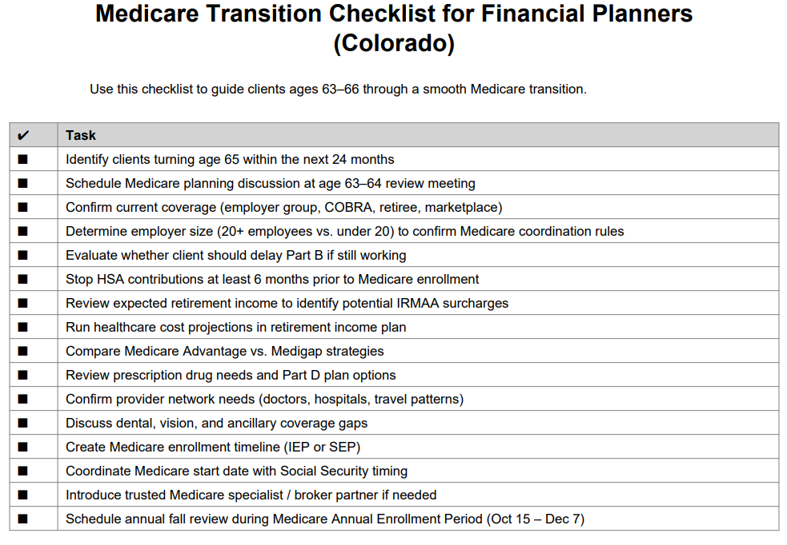
Best practices for financial planners

Slide 43
Medicare coverage trends for 2026
1️⃣ Continued Growth & Restructuring of Medicare Advantage (MA) Plans
📈 Medicare Advantage enrollment remains high and competitive, but carriers are tightening benefits and managing costs more aggressively.
What’s happening in 2026:
Fewer “extra rich” benefit designs compared to prior years
More network restrictions in some markets
Increased focus on utilization management (prior authorizations)
Greater plan differentiation by geography
Why it matters:
Clients may need stronger education on network rules, referral requirements, and plan stability. Benefit comparisons are more important than ever.

Slide 44
Medicare coverage trends for 2026
2️⃣ Ongoing Prescription Drug Cost Changes Under the Inflation Reduction Act (IRA) 💊
Major drug reforms continue to roll out.
Key 2026 impacts:
Continued $2,000 annual out-of-pocket cap for Part D drugs
Expanded Medicare negotiation on high-cost medications
Smoother cost-sharing for specialty drugs
Increased carrier adjustments in formularies
Why it matters:
Clients with high Rx usage may see significant savings — but formulary changes are increasingly important to review annually.

Slide 45
Medicare coverage trends for 2026
3️⃣ Increased Focus on Supplemental Benefits & Value-Based Care 🏥
Medicare Advantage plans continue expanding:
Dental
Vision
Hearing
OTC allowances
Transportation
Food benefits (in some cases)
Chronic condition special benefits (SSBCI)
At the same time, carriers are shifting toward value-based provider contracts.
Why it matters:
Benefits are becoming more targeted — not universal. Advisors must evaluate whether perks are sustainable or marketing-driven.

Slide 46
Medicare coverage trends for 2026
4️⃣ Greater Emphasis on Star Ratings & Plan Performance ⭐
CMS Star Ratings continue to heavily influence:
Plan quality
Enrollment marketing
Bonus payments
Benefit richness
Trend in 2026:
More volatility in ratings
Stricter performance metrics
Increased importance of member experience scores
Why it matters:
Star ratings now directly affect plan stability and benefits. Low-rated plans may reduce benefits or exit markets.

Slide 47
Medicare coverage trends for 2026
5️⃣ Rising Cost Pressures & Plan Design Adjustments 💰
Healthcare utilization and inflation pressures are influencing plan structures.
Common 2026 adjustments:
Higher deductibles in some MA plans
Increased cost-sharing for specialists or hospital stays
Narrower networks in certain regions
More prior authorization requirements
Why it matters:
While premiums may remain low, out-of-pocket exposure can increase. Total cost analysis (not just premium comparison) is critical.

Slide 48
Medicare coverage trends for 2026
🔎 Bonus Emerging Theme (Strategic Impact)
Integration of Medicare with broader retirement planning.
Advisors are increasingly:
Coordinating Medicare with income planning
Reviewing IRMAA strategies
Aligning HSA distribution timing
Addressing tax implications of Part B/D premiums
Medicare is no longer just a health decision — it’s a financial planning decision.

Slide 49

Contact Information
Garry Manchulenko
GMBA Advisors Group
303-704-8842
garrym@gmbaadvisorsgroup.com
www.gmbaadvisorsgroup.com

Slide 50
Q&A Session Begins Now!
Thank you for your participation in this Medicare 101!

