Slide 1


Unlocking Hidden Value:
What financial professionals need to know about reverse mortgages
Monica Elizondo
Mortgage Consultant
NMLS #2042748
melizondo@longbridge-financial.com
(980) 480-1371
Corporate Address:
61 South Paramus Rd
Suite 500
Paramus, NJ 07652
©2026 Longbridge Financial, LLC. NMLS# 957935. 61 S Paramus Rd, Suite 500, Paramus, NJ 07652. These materials are for general information purposes only and are not for use with individual consumers or for distribution to the general public. The information herein is not intended as legal, tax or financial planning advice and should not be relied on or construed as such. These materials have not been reviewed, approved or issued by FHA, HUD or any government agency.
How to use home equity to live a better life

Slide 2
Learning Objectives
Review changes to the HECM program over the past several years that have strengthened consumer protection.
Understand core foundation of reverse mortgages
Demonstrate impact of funds from home equity in improving outcomes for retirement planning and estate planning
Discover unconventional techniques for financing preferred care and appropriate housing
Learn how to “Right-size” a home without downsizing cash flow
©2026 Longbridge Financial, LLC. NMLS# 957935. 61 South Paramus Road, Suite 500, Paramus, NJ 07652. These materials are for general information purposes only and are not for use with individual consumers or for distribution to the general public. The information herein is not intended as legal, tax or financial planning advice and should not be relied on or construed as such. These materials have not been reviewed, approved or issued by FHA, HUD or any government agency.

Slide 3


Baby Boomer Housing Wealth is at Historic Levels
As of September 2025, U.S. homeowners
age 62+ have
$14,600,000,000,000
in housing wealth¹
¹ Source: NRMLA/RiskSpan Reverse Mortgage Market Index . Q3 2025 Senior Home Equity Surges to Record $14.66 Trillion in Q3 2025 - NRMLA

Slide 4
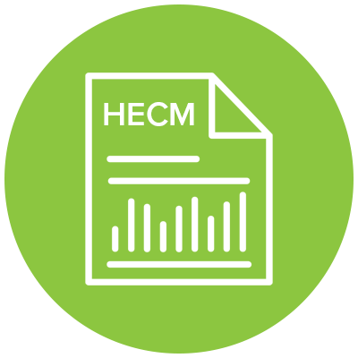
What is a HECM?
Home Equity Conversion Mortgage (HECM) is commonly known as a reverse mortgage
  Federal Housing Administration (FHA) insured loan which allows you to convert a portion of your home’s equity into cash
  The borrower remains on title of the property
  Monthly mortgage payments are not required¹
¹As with any mortgage, you must meet your loan obligations, keeping current with property taxes, insurance, and maintenance.

Slide 5
Rise of the Reverse Mortgage
The vast majority of reverse mortgages are Home Equity Conversion Mortgages (HECM)¹
President Reagan signed the HECM program into law in 1989
The HECM program is federally-insured² by FHA
Over 1.3 million Americans have used a HECM since the program’s inception³
Of the total 22,753 mortgage complaints the CFPB received in 2023, only 1.6% of them were reverse mortgage-related⁴
¹ Source: U.S. Government Accountability Office. https://www.gao.gov/products/gao-19-702
² This material has not been reviewed, approved or issued by HUD, FHA or any government agency. The company is not affiliated with or acting on behalf of or at the direction of HU/FHA or any other government agency.
³ Source: National Reverse Mortgage Lenders Association. https://www.reversemortgage.org/borrowers-stories
⁴ Source: Housingwire.com. “The reverse mortgage lenders with the most consumer complaints in 2023”. January 2024. https://www.housingwire.com/articles/the-reverse-mortgage-lenders-with-the-most-consumer-complaints-in-2023

Slide 6
The Evolution of the Reverse Mortgage
First ever reverse mortgage issued by Nelson Hayes to help Nellie Young
Under Reagan, 1st FHA-insured¹ HECM
HUD establishes Non-Borrowing Spouse policies
HECM for Purchase introduced
HUD finalizes guidelines for Financial Assessment
HECM Loan Limit raised to $1,089,300
& $1,149,825
HECM Loan Limit raised to:
$1,209,750
1961
1989
2009
2014
2015
’23 & ‘24
2025
2001
¹ This material has not been reviewed, approved or issued by HUD, FHA or any government agency. The company is not affiliated with or acting on behalf of or at the direction of HUD/FHA or any other government agency.
©2026 Longbridge Financial, LLC. NMLS ID # 957935. NOT FOR FURTHER DISTRIBUTION.

Slide 7

Home Equity Conversion Mortgage (HECM) Basics
Borrower must be age 62+
  Non-Borrowing spouse must be at least 18
The home must be the borrower’s primary residence
Available equity is typically 35-70% based on age and interest rate
  The higher the interest rate, the lower the percentage of the home’s value can be accessed
  Lender makes income tax-free payments to homeowner
FHA insured HECM is a non-recourse loan
  No liability above home value

Slide 8







Flexible Funding Options¹ Available with a HECM
Lump sum
A combination of these – chosen by borrower
Growing Line of Credit²
Purchase a new home
(HECM for Purchase)
Fixed monthly advances
Term (Fixed Period of Time)
Tenure (Lifetime Payment)
¹ Borrowers who elect a fixed rate loan will receive a single disbursement lump sum payment. Other payment options are available only for adjustable-rate mortgages.
² If part of the borrower’s loan is held in a line of credit upon which they may draw, then the unused portion of the line of credit will grow in size each month. The growth rate is equal to the sum of the interest rate plus the annual mortgage insurance premium rate being charged on their loan.

Slide 9
The Three “Buckets” of Costs
Lender credits may be available to reduce costs
FHA Mortgage Insurance Premium (MIP)
Transaction Costs
Origination Fee
Fully non-recourse to heirs and the estate / Credit Line Growth
Initial MIP = 2% of the home value (up to the Max)
Annual = 0.5% of the outstanding loan balance
Closing Costs – appraisal, state fees, title insurance, etc.
Counseling – varies by agency, but typically between $125 to $200
Lender’s origination fee – Set by FHA, based on home value
Discounts and credits are often available

Slide 10
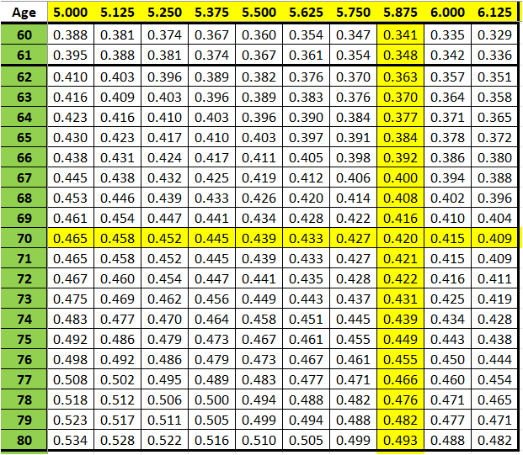
How much do we get?
Principal Limit Factor (PLF)

Slide 11
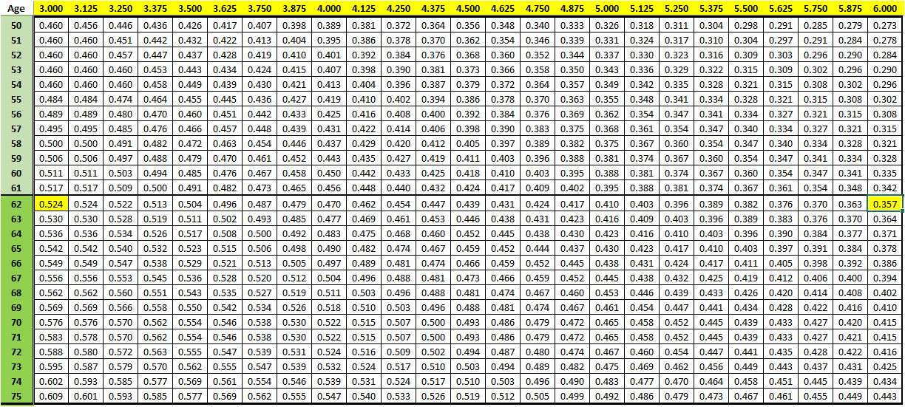
How much do we get (Cont’d)
Principal Limit Factor (PLF) Table

Slide 12
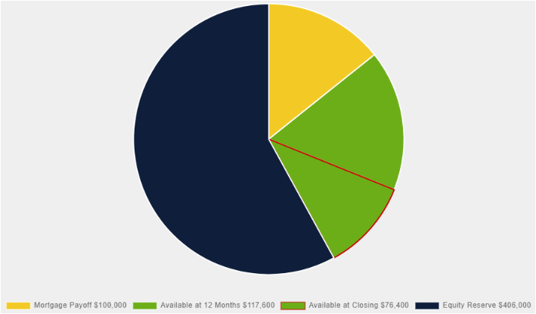
How much do we get?
Age: 70
Home Value: $700,000
Expected Interest Rate: 5.875%
Principal Limit Factor (PLF): 42%
Principal Limit: $294,000
Mortgage Payoff: $100,000
Available Principal Limit: $194,000
Equity Reserve*: $406,000
$100,000
$406,000
$194,000
*Interest will accrue on the outstanding loan amount and be added to the loan balance. Remaining equity displayed is an estimate at the commencement of the loan. Remaining equity is not guaranteed as the loan balance grows.

Slide 13
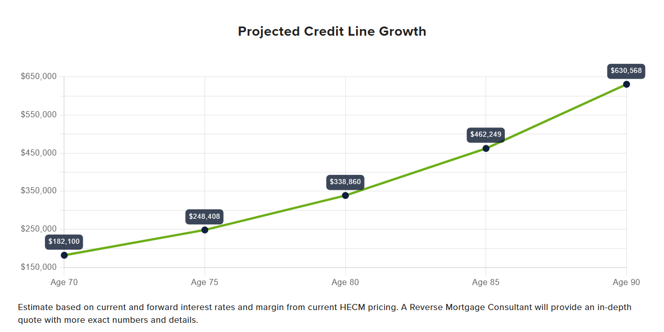
Projected Credit Line Growth
Projected credit line would grow to $462,249 by age 85
Funds could be drawn down for home care or any other purpose
No additional income taxes on HECM funds used
No disruption to portfolio performance or lifestyle
*Estimated based on current and forward interest rates and margin from current HECM pricing. Please obtain a quote for more exact numbers and details.

Slide 14
Funding the Rising Costs of Aging Safely in Place

Slide 15
Health Care May Be the Biggest Financial Burden Facing Retirees Today
"
Those closest to retirement today should expect a minimum of $30,000 to $40,000 in health care costs during retirement, even with Medicare.
When you add long-term care costs, the amount they need suddenly balloons to over $300,000.
- Executive Director, Center for Retirement Initiatives
at Georgetown University, November 2022
88% of U.S. seniors say it’s important to remain in their homes as they age¹
"
¹ Source: Robinson-Lane S, Singer D, Kirch M, Solway E, Smith E, Kullgren J, Malani P. Older Adults’ Preparedness to Age in Place. University of Michigan National Poll on Healthy Aging. April 2022.
Source: Axios.com. “Baby boomers face a unique caregiving crisis.” November 2022. axios.com/2022/11/19/baby-boomers-elder-care

Slide 16
Average In-Home Care Costs¹
In 2024, the average cost of 40 hours a week of in-home non-medical care and assistance in the U.S. is $5,417/month
24/7 in-home non-medical care averages $20,455/month
In 2024, the average cost of 40 hours a week of in-home health care with a certified aide/nurse in the U.S. is $5,625 per month
24/7 in-home health care averages $21,240/month
Alternatively, residential skilled nursing care in a facility costs a national average of $8,641/month for a shared room and $9,872/month for a private room
¹ Source: What Is Home Care and How Much Does it Cost? (payingforseniorcare.com)

Slide 17
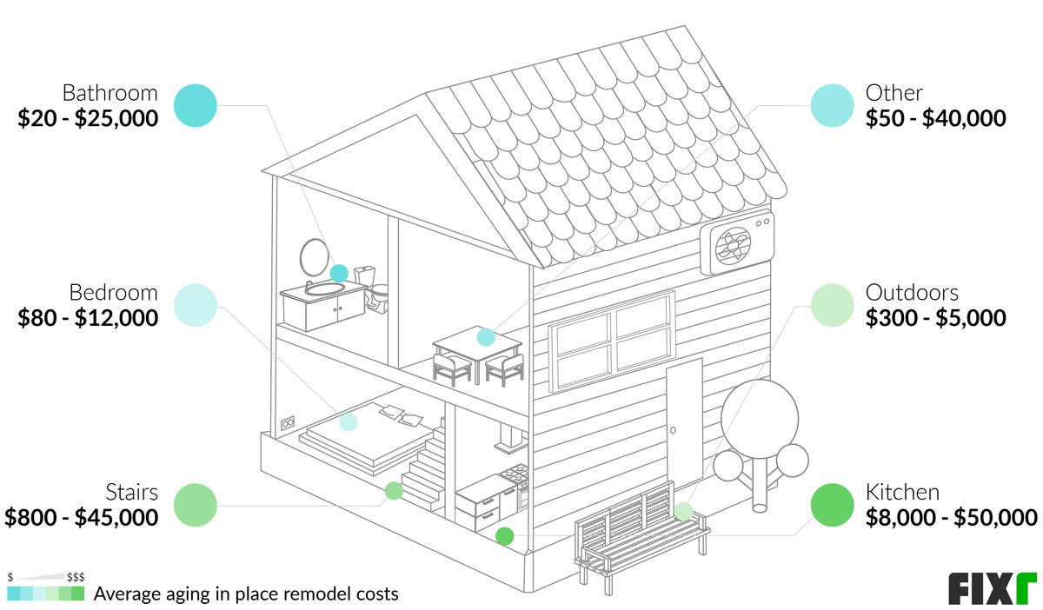
Average Aging in Place Remodeling Costs
Source: Fixr.com. “How much does it cost a remodel to adapt a home for aging in place?” August 2022. fixr.com/costs/aging-in-place-remodeling

Slide 18

Funding Longevity with a HECM Line of Credit
Meet the Davis Family
  The Davis couple, both age 68, have a $575,000 home with no mortgage. They have a pension and $500,000 in portfolio assets.
  How can a reverse mortgage help the Davis's better achieve their retirement goals?
©2023 Longbridge Financial, LLC. NMLS ID # 957935. NOT FOR FURTHER DISTRIBUTION.

Slide 19
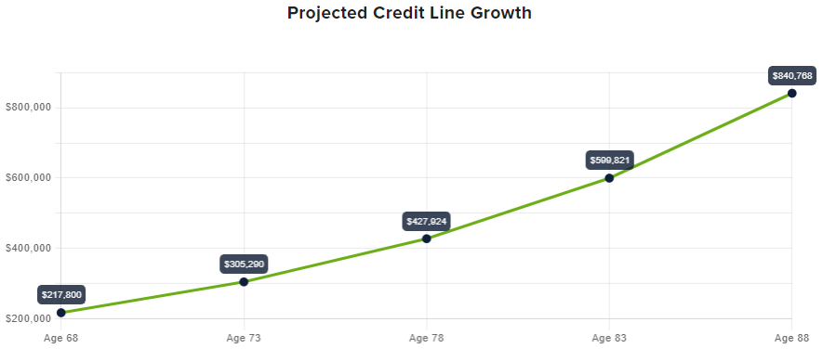
Funding Longevity with a HECM Line of Credit
Solution: Establish a HECM Credit Line
By age 85, projected credit line would grow to $599,821
Funds could be drawn for in-home care, Social Security, bridge, or any other purpose
No additional income taxes on HECM funds used
Information shown for illustrative purposes only. Assumptions are: (1) 68-year-old borrower; (2) Washington home valued at $550,000; (3) LOC will grow at 2.00% above the HECM CMT MCap5 Adjustable-Rate Mortgage (ARM), which uses the 1-year CMT plus a margin of 2.0%. Initial APR is 7.26% which can change annually. 2% annual interest cap, and 5% lifetime interest cap over the initial interest rate. Maximum interest rate is 12.26% (4) the rate remains at 7.26%; (5) no draws by borrower. Interest rates and funds available may change daily without notice.
©2023 Longbridge Financial, LLC. NMLS ID # 957935. NOT FOR FURTHER DISTRIBUTION.

Slide 20
Eliminating a Mortgage Payment for an easier Path to Retirement.

Slide 21

Eliminating Mortgage Payments for an Easier Path to Retirement
Meet Henry
  Henry is 62 years old, single, and has a $650,000 home with $175,000 remaining on his mortgage. He is still working full-time.
  With a current rate at 3.75%, he will be making mortgage payments of $1,850 per month for close to 10 years, well into his intended retirement.
The Challenge
  Henry plans to retire at 67 but is concerned about making his
  monthly mortgage payment from retirement income.
  He has saved but would also like to have more liquid funds
  available for contingencies.
  He would like to find a way to make retirement work without
  having to extend his planned retirement date.

Slide 22
The Solution
Eliminate monthly mortgage payments by replacing Henry’s traditional mortgage with a payment-optional HECM¹
Shift $1,850/month ($22,200/year) toward savings, increasing his deductible 401(k) contribution and maximizing income deferral/matching funds
After paying off the mortgage and the cost to set up the mortgage, Henry has $45,500 available credit line from his HECM
Henry can potentially save approximately $222,000 in mortgage payments over the 10 years remaining on his mortgage, that can be used for other retirement goals.
¹ Real estate taxes, homeowners insurance, and property maintenance required.

Slide 23
Longbridge Platinum
Proprietary reverse mortgage

Slide 24

Longbridge Platinum Highlights
Loan amounts up to $4 million in available cash and wide range of eligible homes¹
Available to homeowners as young as age 55 in select states²
No mortgage insurance premium = potentially lower up-front costs
No mandatory repayment obligation
Non-recourse protection
Expanded eligibility for condos
Streamlined approval process
¹ The state of MA has a maximum loan amount/lending limit of $2,000,000.
² Available to borrowers as young as 55 in select states only. Higher minimum age requirements may apply.
Longbridge Platinum Reverse Mortgage (“Platinum”) is Longbridge Financial LLC’s proprietary loan program and is not affiliated with the Home Equity Conversion Mortgage (HECM) loan program, which is insured by FHA. Platinum is available to qualified borrowers who also may be eligible for FHA’s HECM program or are seeking loan proceeds that are higher than FHA’s HECM program limit. Platinum currently is available only for eligible properties in select states. Please contact a loan originator to see if it is currently available in your state.

Slide 25
Platinum Peak
Designed to deliver some of the best lending limits and proceeds available in the market
  A game-changer that helps borrowers maximize their home equity like never before
  Ideal for clients who:
    Are seeking to maximize their cash flow
    Were previously short-to-close due to LTV constraints
    Seek a fixed-rate loan with a predictable structure
    Want to purchase a home
    Are younger (ages 62-70) and will benefit the most from higher proceeds

Slide 26
Key Features of Platinum LOC
Reusable Line of Credit: Flexible access for 10 years
Low Initial Costs: No initial MIP and minimal closing fees
Easier Income Qualification: Streamlined process
No Required Monthly Mortgage Payments: As long as taxes, insurance, and upkeep are maintained
No Personal Recourse: Protection for borrowers (and their heirs)
Borrower Benefits of Reverse Mortgages: Including title retention,* flexibility, and peace of mind.
* Keeping current with property taxes, homeowners insurance, and home maintenance required.

Slide 27
Platinum Preserve™️
Offers homeowners a way to access their home equity while safeguarding a portion for future needs or to leave a legacy
  Available exclusively with fixed-rate Platinum Max loans
  Borrowers tap into their home equity now while reserving 10-40% for the future
Ideal for clients who want to:
  Safeguard a portion of their equity to protect their legacy and leave as an inheritance
  Create a financial cushion while still accessing a lump sum of cash
  Avoid upfront initial mortgage insurance premium (IMIP) costs of traditional reverse mortgages and maintain long-term security
  Have peace of mind knowing their estate and heirs are protected
“Platinum Preserve” is an option available in certain states which, if chosen, allows borrowers to preserve a percentage of the equity of the property, under certain circumstances, at the conclusion of the loan. Subject to terms and conditions of the Platinum Preserve program. Please contact Longbridge Financial LLC for more details.

Slide 28


Line of credit with a fixed-rate¹ per draw secured by the borrower’s home equity
Interest-only payments for the life of the loan (borrowers must meet loan obligations, keeping current with property taxes, insurance, and maintenance)
Principal repaid when a maturity event occurs, such as if the home is sold or if the borrower no longer meets loan terms
Fully automated, online process with fast access to funds
¹ HELOC For Seniors™ is an open-end product where a minimum of 80% and up to a maximum of 100% of the full loan amount (less the origination fee and costs) must be drawn at closing. The initial amount funded at origination will be based on a fixed rate; however, this product contains an additional draw feature. As the borrower repays the balance on the line, the borrower may make additional draws during the 10 year draw period. If the borrower elects to make an additional draw, the interest rate for that draw will be set as of the date of the draw and will be based on an Index, which is the Prime Rate published in the Wall Street Journal for the calendar month preceding the date of the additional draw, plus a fixed margin. Accordingly, the fixed rate for any additional draw may be higher than the fixed rate for the initial draw.

Slide 29
Traditional HELOC vs HELOC For Seniors®
Traditional HELOC | HELOC For Seniors®
Monthly payments include both interest and principal | Interest-only payments keep monthly costs low and manageable for the life of the loan¹
Variable interest rates can rise over time, resulting in massive, unexpected payment spikes. | A fixed interest rate per draw² of up to $400,000³ allows financial stability without the risk of payment spikes from variable interest rates.
Strict income requirements could make qualifying difficult. | Even on a fixed income, homeowners may qualify based on available home equity.
¹ Loan obligations must be met, like keeping current with property taxes, insurance, and maintenance
² HELOC For Seniors™ is an open-end product where a minimum of 80% and up to a maximum of 100% of the full loan amount (less the origination fee and costs) must be drawn at closing. The initial amount funded at origination will be based on a fixed rate; however, this product contains an additional draw feature. As the borrower repays the balance on the line, the borrower may make additional draws during the 10-year draw period. If the borrower elects to make an additional draw, the interest rate for that draw will be set as of the date of the draw and will be based on an Index, which is the Prime Rate published in the Wall Street Journal for the calendar month preceding the date of the additional draw, plus a fixed margin. Accordingly, the fixed rate for any additional draw may be higher than the fixed rate for the initial draw.
³ Unless a lower loan amount is required under applicable law, loan amounts range from a minimum of $50,000 to a maximum of $400,000. Your maximum loan amount may be lower than $400,000, and will ultimately depend on your home value, lien position, credit profile, verified income amount, and equity available at the time of application. We determine home value and resulting equity through independent data sources and automated valuation models.

Slide 30
Rightsizing a Home Without Downsizing Cash Flow

Slide 31
How Will Your Older Clients Buy Their Next Home?
All Cash | Traditional Mortgage | Reverse Mortgage for Purchase
Client owns the home free and clear | Option to make a minimum down payment and limit up-front investment | Flexible payment feature: Monthly principal and interest payments are optional¹
 | Builds equity as client pays down the loan | Can give client the ability to buy a more expensive home by increasing their buying power
 |  | Allows client to keep more savings and assets intact and can increase monthly cashflow
¹Borrower must keep up to date with real estate taxes, homeowners insurance, and property maintenance

Slide 32

Buying a Home with a HECM to Improve Retirement Liquidity
Meet the Wilson Family
  Mr. & Mrs. Wilson, age 65 and 67, plan to purchase a new home closer to family with cash to avoid a mortgage payment
The Challenge
  The couple plans to sell their current home, clearing $500,000 and buy a new home with a total cost of $500,000
  However, they also want to improve their retirement liquidity – is there a better option?

Slide 33
Buying a Home with a HECM to Improve Retirement Liquidity
Traditional Purchase
Proceeds from current home | $500,000
Purchase price: New Home | $500,000
Cash paid by homeowner | $500,000
Monthly mortgage payment | $0
Client’s remaining proceeds from old home sale | $0
HECM for Purchase (H4P)
Proceeds from current home | $500,000
Purchase price-new home Closing Costs | $500,000 ~$15,000
Reverse mortgage pays Cash paid by homeowner | $195,500 $319,500
Monthly mortgage payment | $0
Client’s remaining proceeds from old home sale | $180,500

Slide 35

Your Clients Can Be Confident with Longbridge
Longbridge is committed to providing the highest level of customer service – we maintain an A+ rating with the Better Business Bureau and an average customer satisfaction rating of 4.7 out of 5 stars from Trustpilot®
We offer competitive pricing in addition to low rates and other special programs for those who qualify
Reverse mortgages are all that we do – our knowledgeable staff has years of experience and are true professionals in the industry
Unlike most lenders, we are a full loan servicer – we stay
committed to each client through underwriting, closing,
and servicing of their loan

Slide 36

How We Help
One-on-one attention with a designated Account Executive
Complimentary in-depth quotes
Special pricing for advisors
Educational resources on all things reverse
Online tools to run scenarios – 24/7/365
Monica Elizondo
Mortgage Consultant
NMLS #2042748
Phone: (980) 480-1371
Email: melizondo@longbridge-financial.com

